Slide 1

Tyne Estuary Partnership:​
Placement Journey
Eliza Wauchope
2nd year Newcastle University Politics student

Slide 2
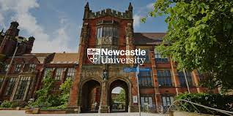
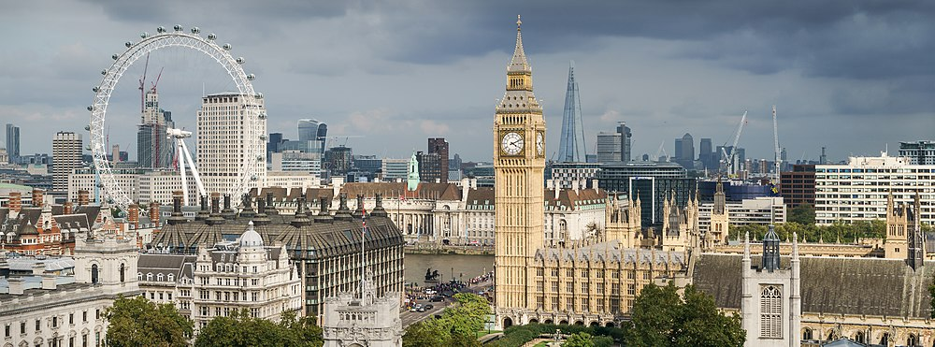
A bit about me ….
Notes:
I just thought I would give a little bit of background about me. I grew up in London or more specifically Lambeth, first going to blackheath high school for girls and then on to Stowe school. All my life I had lived in London until I moved to Newcastle as I started studying Politics at Newcastle university. At the moment, I am in my second-year and the reason I am here is as one of the modules I selected was a placement module.

Slide 3
Why Groundwork ?
Outcome:
Increased and wider range involvement in heritage
People will have learned about heritage, leading to a change in ideas and actions
People will have greater wellbeing
To find out the opinions of the public which will help establish Lottery funding
Community
Environment
Learning something new
Notes:
So why did I choose to do my placement with Groundwork? After reading the groundwork brief,I was very intrigued to find out more about the projects that would benefit my community and surrounding environment. I have always been intrigued about the environment and potential ecological benefits but having not studied geography past GCSE, I never really understood it all. Therefore, Groundwork appealed to me as I wanted to understand how and what the proposed projects are but also what is the publics opinion on them are.
After selecting groundwork and being introduced to Hellen, my role was clearly outlined to establish base line data in order to measure the impact of the project interventions on personal well-being, engagement with heritage and public perceptions of the the Tyne river. The data established would then be used as evidence to how the project will meet the outcomes listed

Slide 4
Tasks
Target audience
Opinions
Plan
Notes:
From the offset there were 3 main tasks I took on:
· identify the target audience and importantly to find out how to best contact or find them.
· to find out their opinions on the projects and how this changed depending on how they used the Tyne.
·plan timescales and create a plan of action in order to do this efficiently

Slide 5
Surveys/Sectors
Educational
Residential
Business
Notes:
Once establishing that surveying was the best way to achieve this task, Hellen and I also identified that In order to reach the right audience and to collect the most accurate data we would need to create more than one survey and categories the questions asked. We decided to create 3 surveys centered around the educational, business and residential sectors.

Slide 6
Questions
What is your postcode?
What would encourage you to visit The Tyne?
How during the pandemic have you engaged with your local environment ?
Notes:
However, we established that in all three surveys, standard questions needed to be asked in order to identify basic information of the respondents. The area or, more specifically postcode, of the person answering the survey was important as it would be needed in order to corelate the results to a specific environmental project due to the location. On top of this, there were a few questions which ran across each sector which were to do with the current pandemic and generalized use of the Tyne.

Slide 7
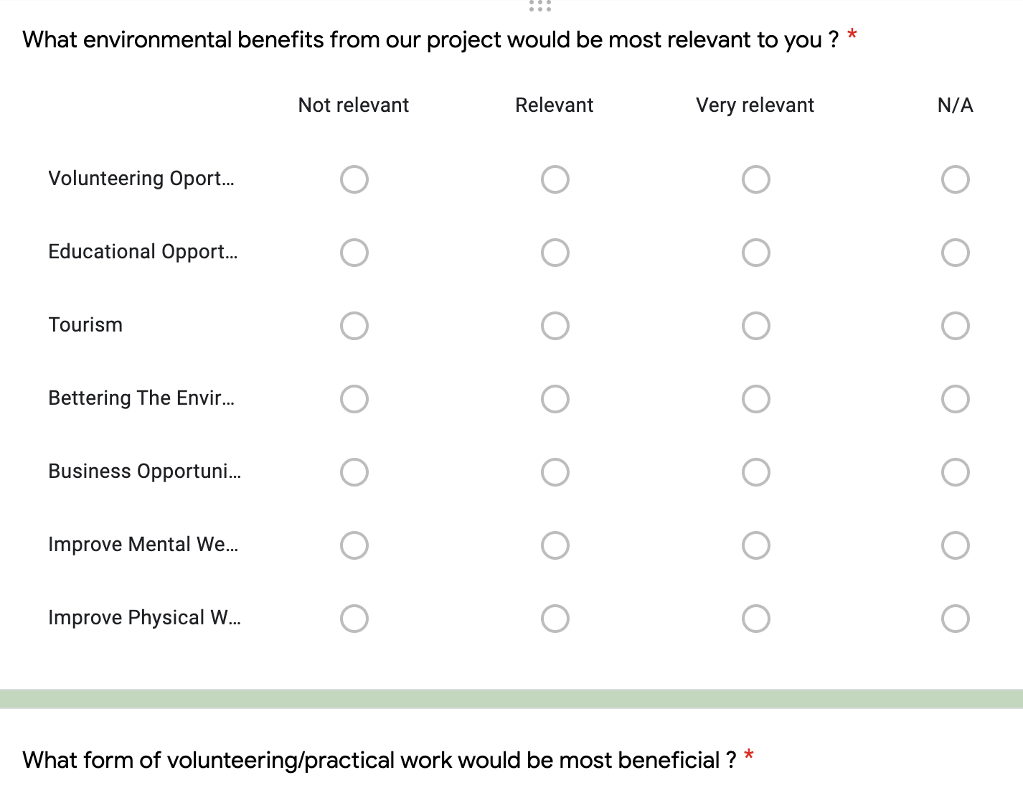
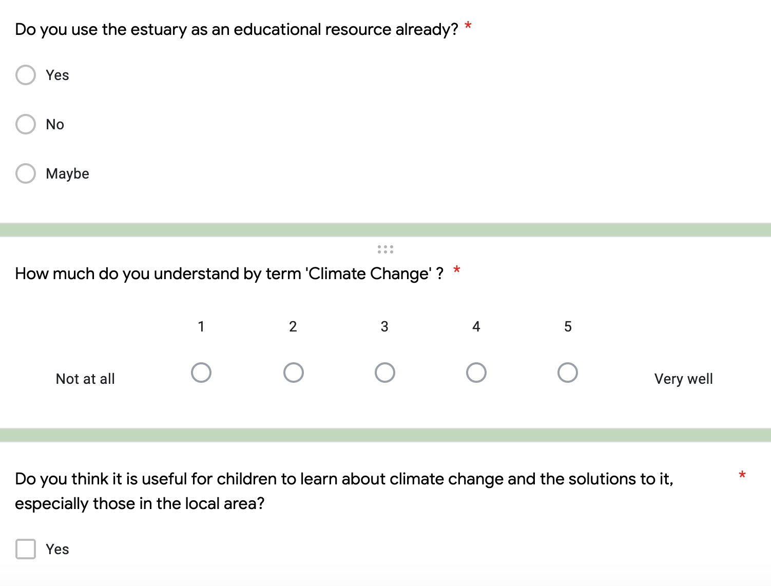
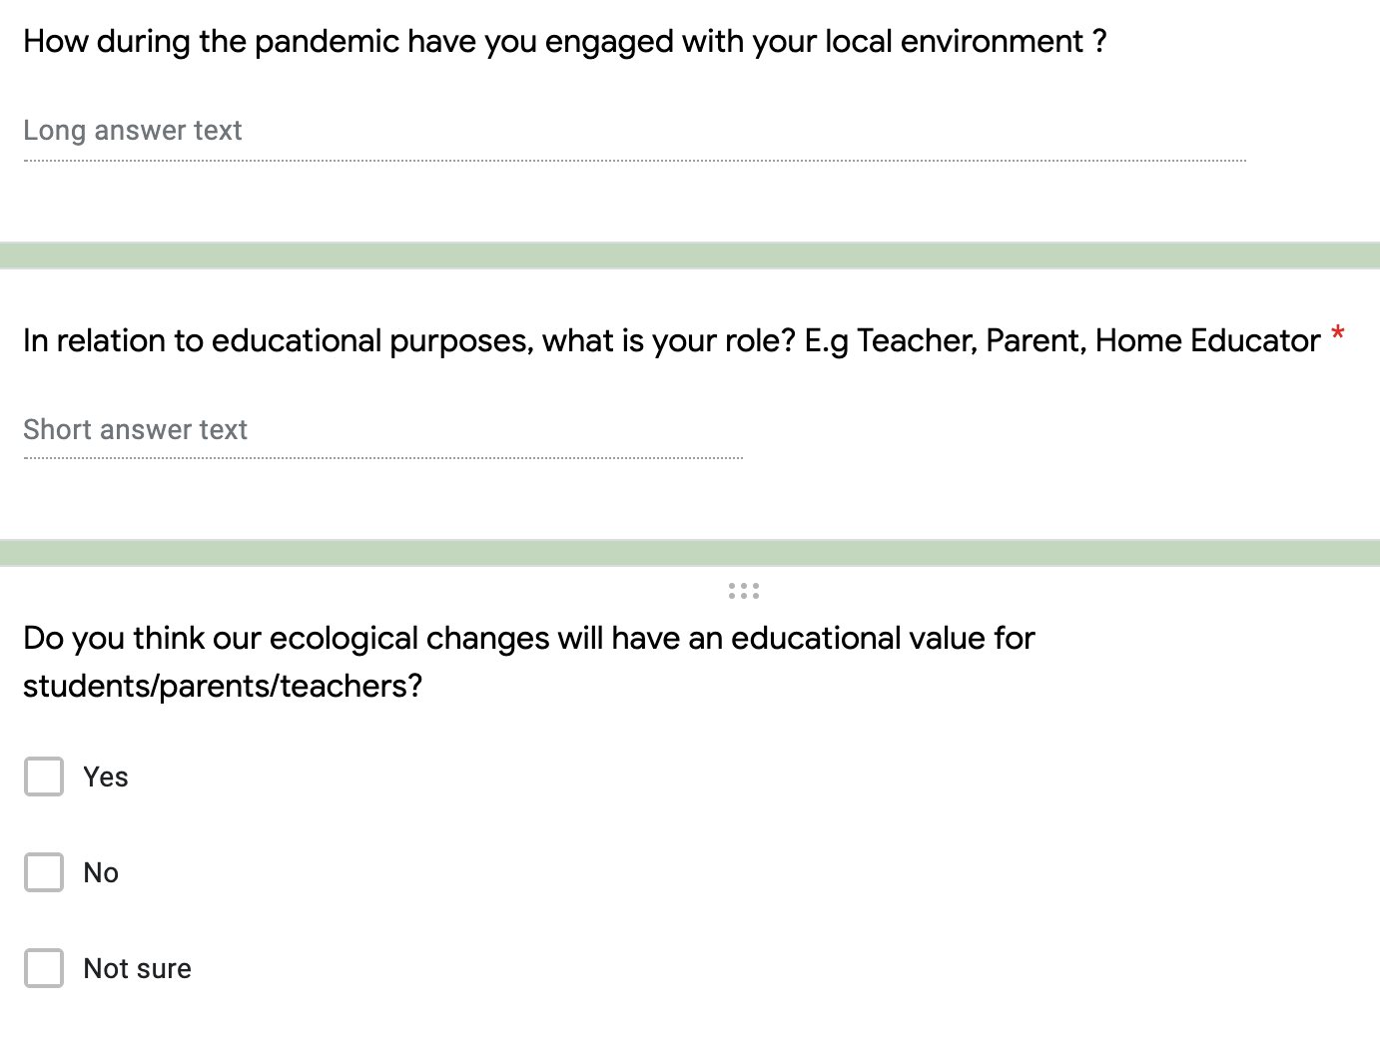
Educational Survey
Additional Educational benefits
Subjects/classes
Curriculum
Talks and how we could educate
Notes:
Our first survey created was the Educational survey. This aimed to ask question to teachers, parents and students in order to identify the benefits and negatives that they thought the proposed projects would bring the educational sector. We wanted to identify which subject areas would benefit from the planned works and how the projects could be used to teach the community about important environmental issues such as climate change. The Questions in the Education survey were also designed to find out how The Partnership could aid in teaching the community about the environment and informing them about the proposals.

Slide 8
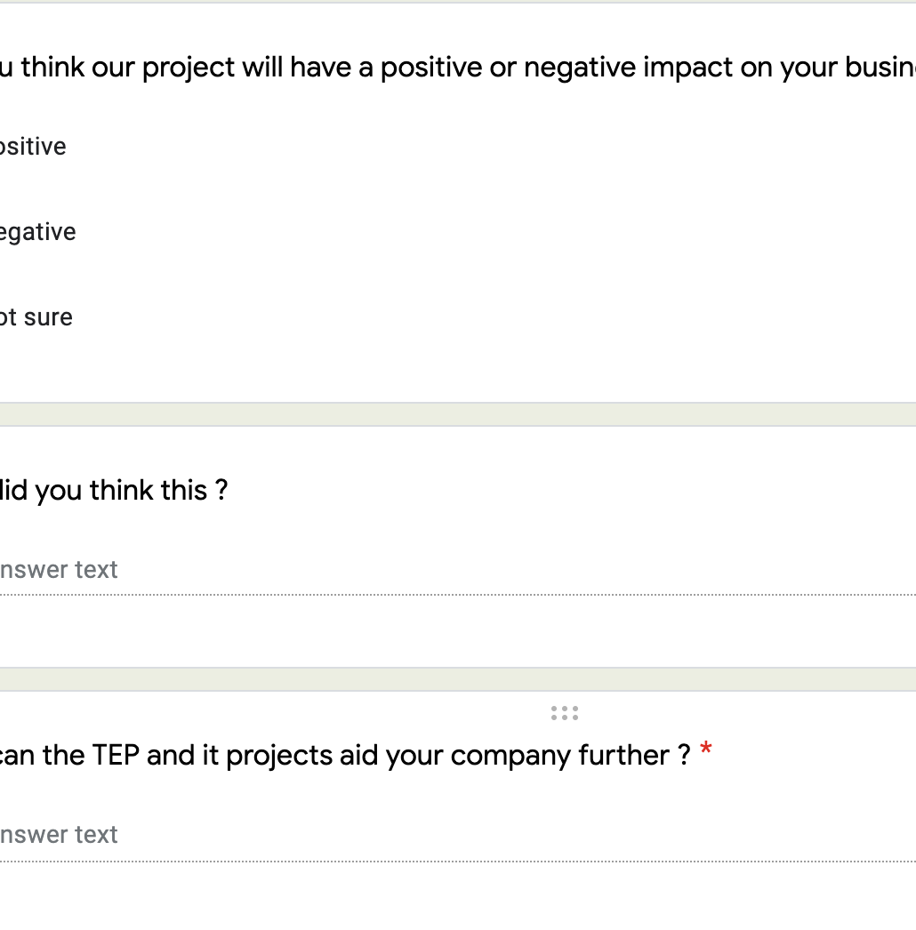
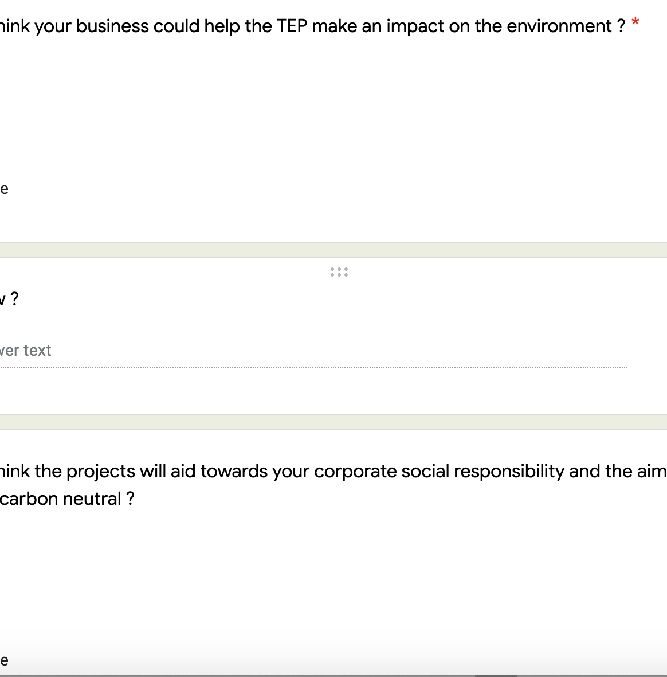
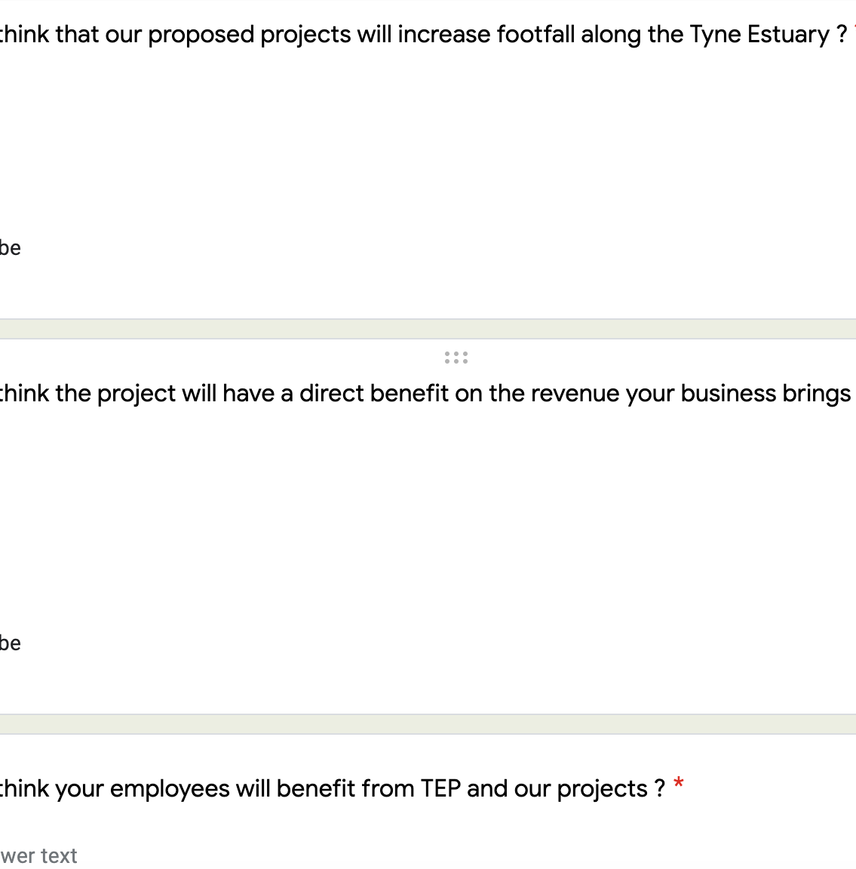
Business survey
Footfall increase
Increase employee satisfaction
Business impact on the environment
How can they aid the TEP?
Notes:
The next survey which was concentrated on was that aimed at the business sector. This intended to ask questions to business owners and employees in order to identify the benefits and negatives the proposed plans would have on their business as well as employee wellbeing. Through this survey we aimed to identify how the TEP can aid businesses in becoming more environmentally conscious as well as how the projects will increase the amount of football they receive. This survey, aimed at the business sector, was deliberately very short as, we determined that many business owners don’t have the time to answer surveys but if it was shorter, they were more likely to do so.

Slide 9
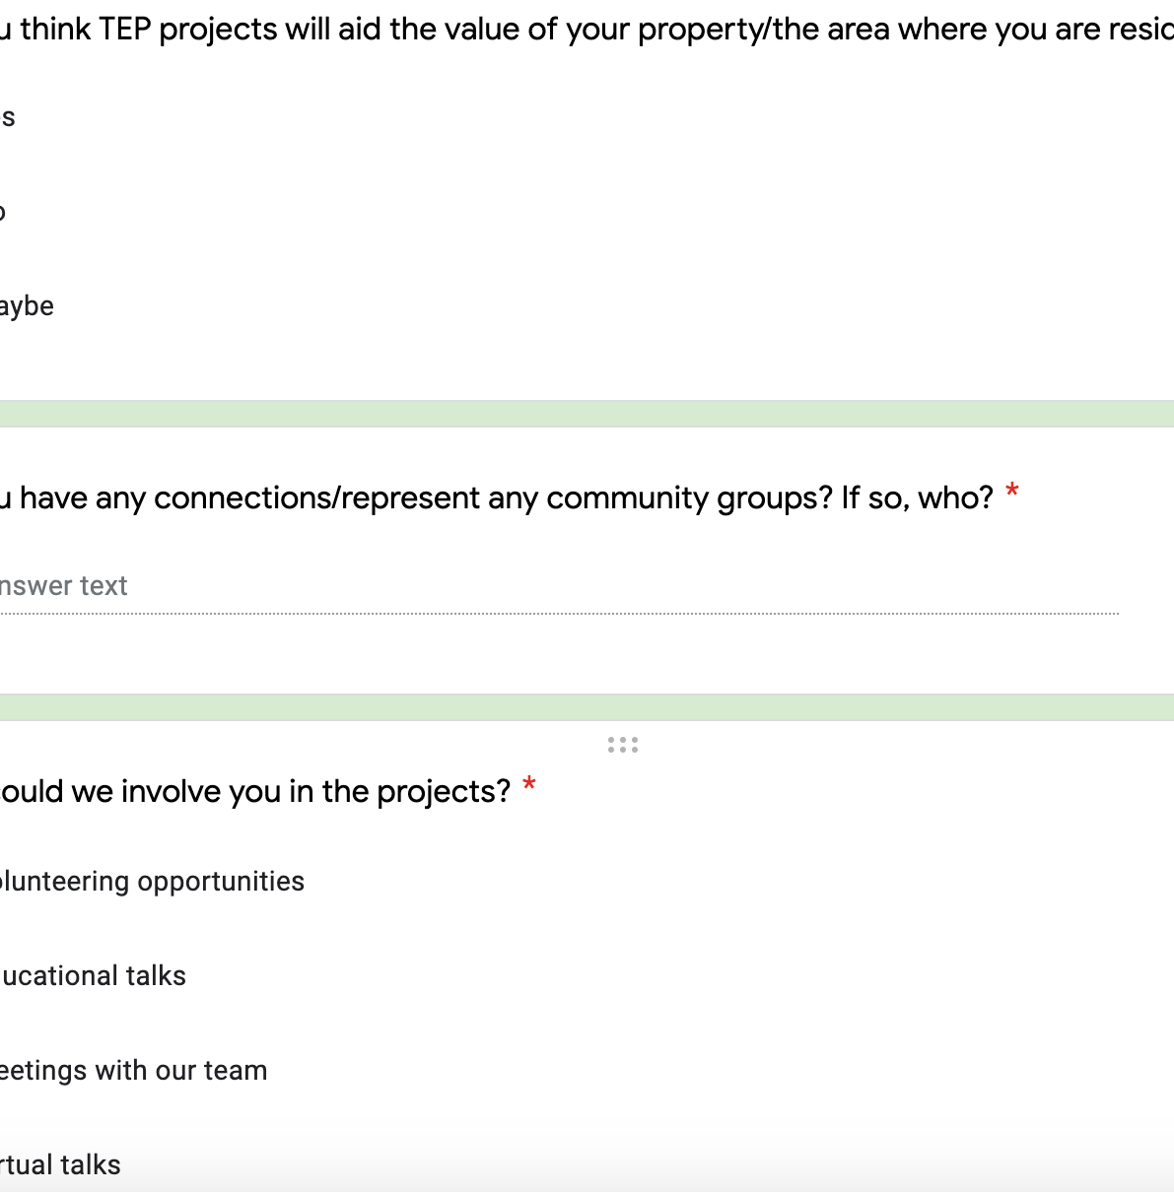
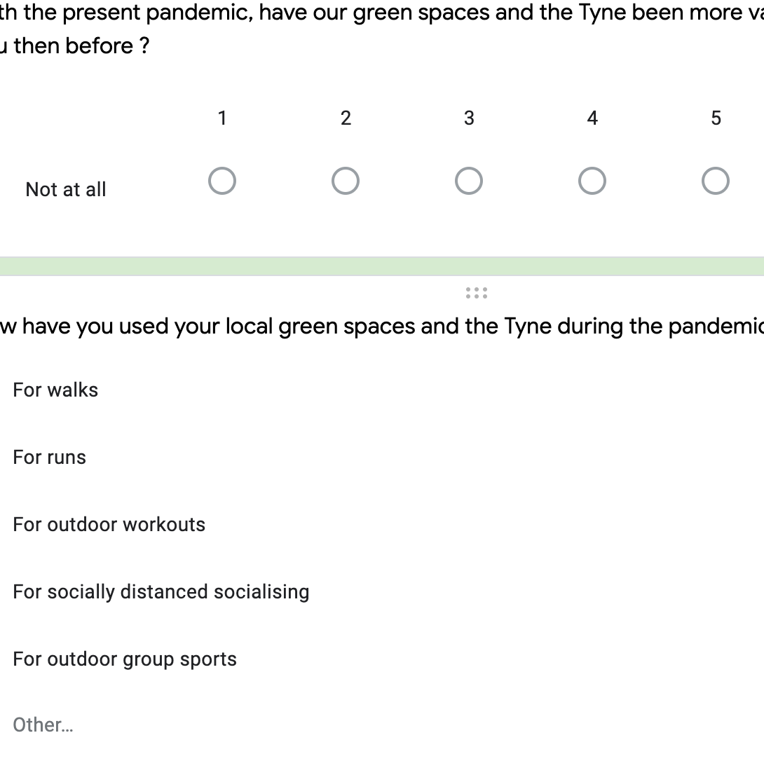
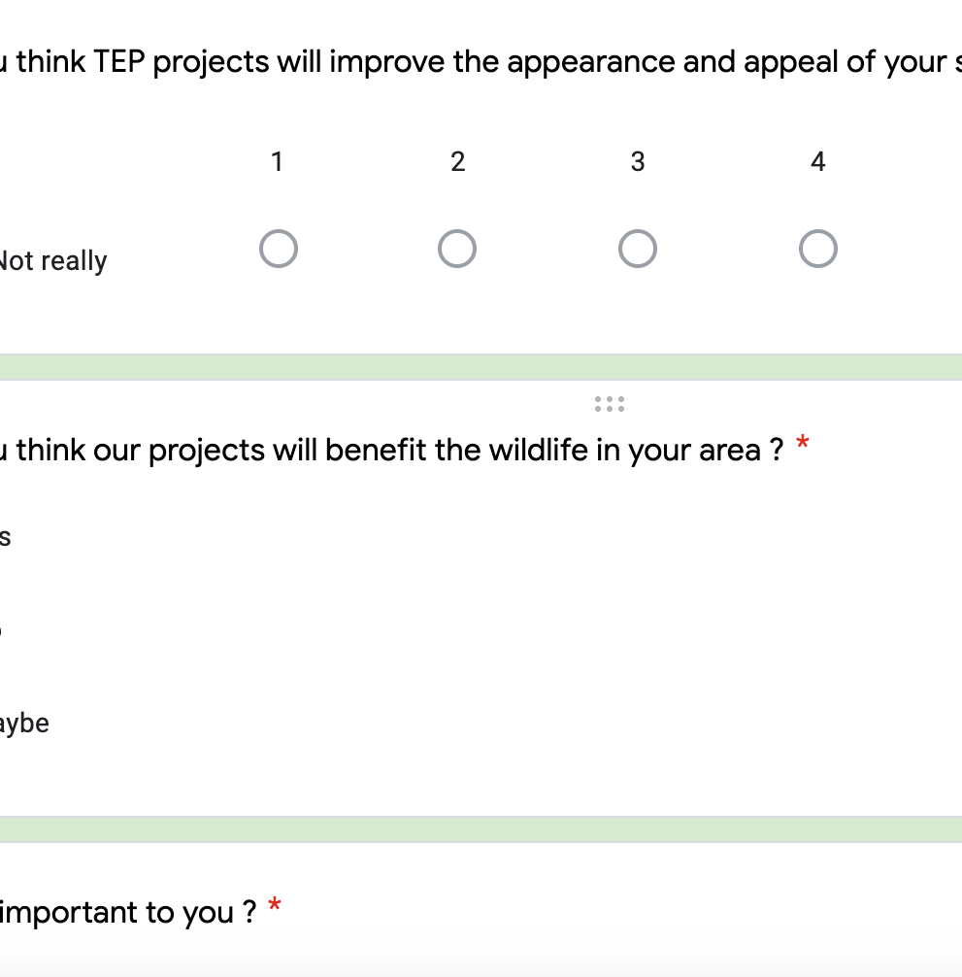
Residential survey
Improve surroundings
Covid – physical/mental wellbeing
Property prices
Notes:
The next survey concentrated on was the Residential sector. This survey aimed to identify the how and if residents and residential property owners would benefit from the proposed planned, especially with the importance of green spaces during the pandemic. The residential survey also aimed to find out if house prices and values would increase due to the proposed plans which would therefore benefit the residents.

Slide 10
The Response
Educational - 3
Residential - 19
Business - 5
Notes:
At the moment we have been overwhelmed from the great responses to the residential survey but would want more responses on the educational and business surveys.
In order to do this, we will try and get these survey out to more people and connections who are either involved or know people who are involved in the educational sector.
I think the lack on response on some of the surveys has been down to the difficulty to get them out to school and businesses as they were closed due to the pandemic.

Slide 11

Next steps:
Educational and residential survey interaction increased
New survey methods?
Comparison
Notes:
Therefore, I think the next steps of this project are to really encourage more responses of education and residential survey. Part of the way I think we will get more interaction, which will hopefully be possible soon, is trying different survey methods, such as sending leaflets doors to door and getting the word about by going into schools. After speaking with Juliet Staples and Fearghus O'Sullivan, who carried out a similar survey, I found out they got the best responses by delivering physical surveys to organisations and thus this I think should be the next step to establish more responses.

Slide 12

Questions

